Slide 1
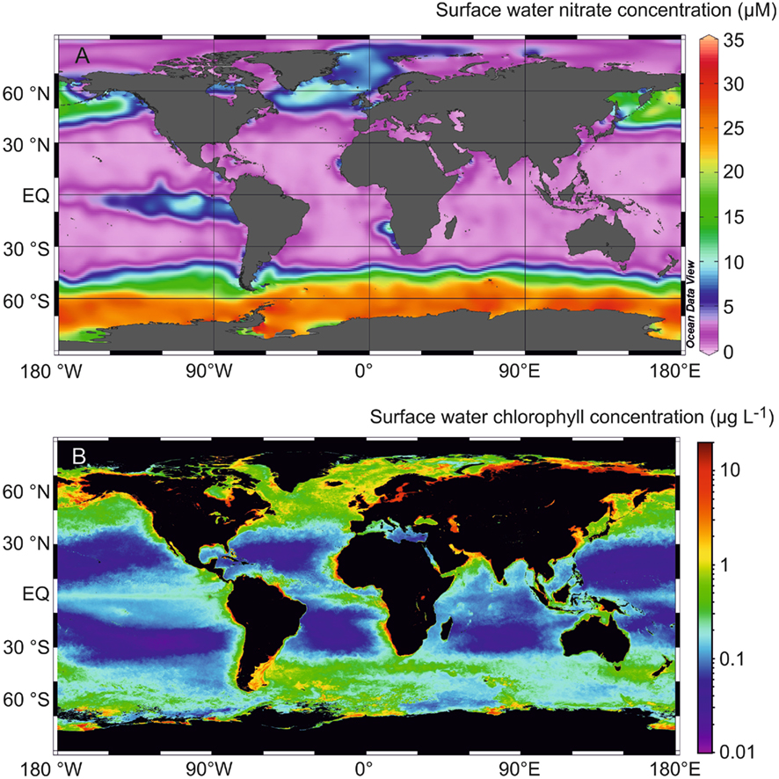
Nutrients and productivity II
31 May
2017

Slide 2
The phosphorus (P) cycle
Essential nutrient: DNA, RNA, and energy transfer (adenosine triphosphate, ATP), membranes, bone
Ocean’s P budget largely controlled by geological and geochemical processes
Oceanic concentrations: 0-3 μmol/L
Residence time in the ocean of 20-40 kyrs
Mainly dissolved orthophosphate (phosphate): PO₄³⁻

Slide 3
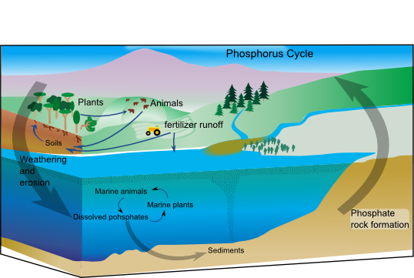
The phosphorus (P) cycle
1. Exposure of P-bearing rocks/soils (uplift)
2. Chemical weathering and physical erosion
3. Transport by rivers
4. Sedimentation and burial: phosphate rock formation
The marine P cycle has geological and geochemical inputs and outputs

Slide 4
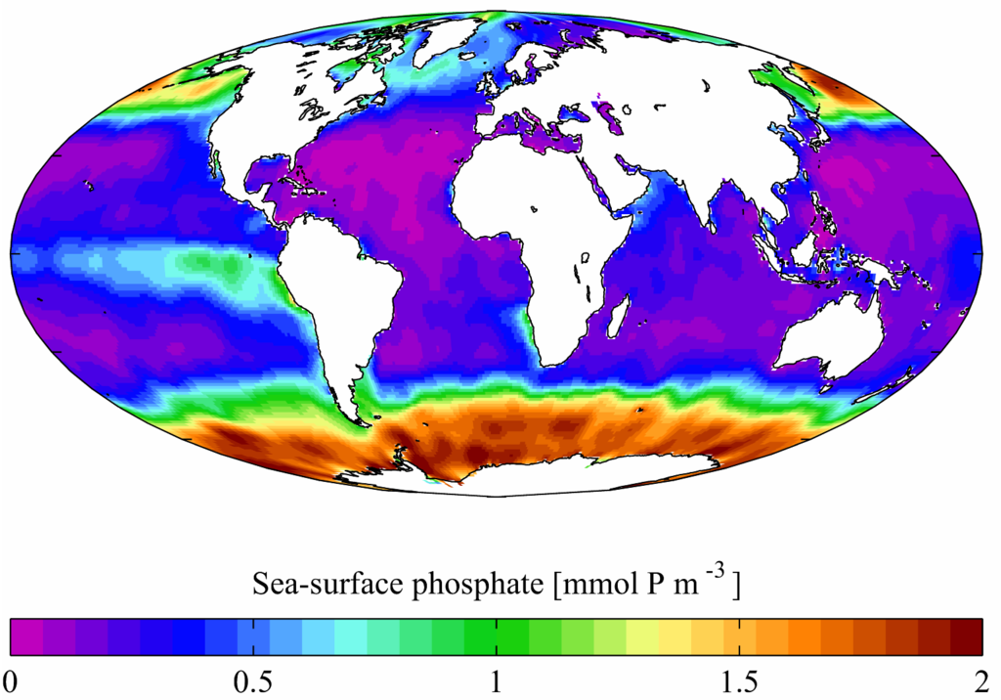
Global ocean surface PO₄³⁻ distribution
[PO₄³⁻] (μM)

Slide 5
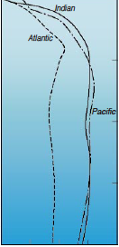
Vertical profiles of PO₄³⁻
[PO₄³⁻] (μM)
0 1 2 3 4
0
Indian
Atlantic
1000
Pacific
Depth (m)
2000
3000
4000
Ruttenberg 2009

Slide 6
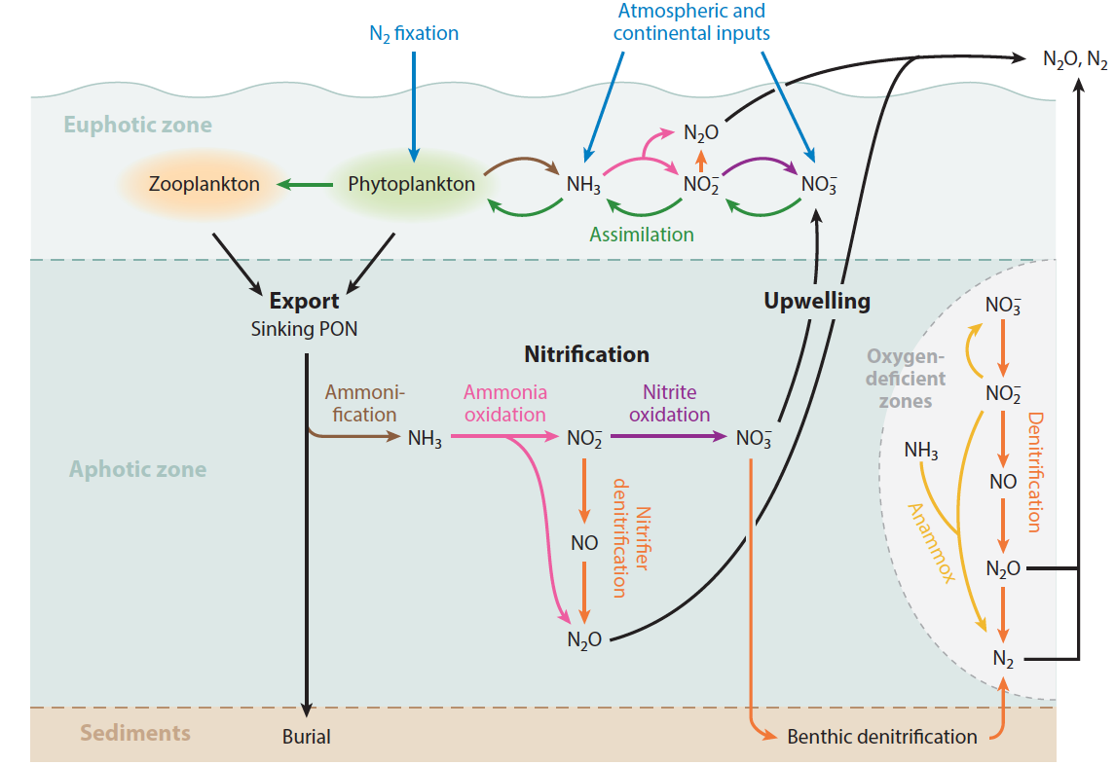
The marine nitrogen (N) cycle
Casciotti et al. 2016

Slide 7
The marine nitrogen (N) cycle
Essential nutrient: chlorophyll, proteins (amino acids), DNA, RNA
Input/output budget is largely biologically controlled
Exists in numerous forms/oxidation states (“bioavailability”)
Oceanic residence time of ~3000 years

Slide 8
Input: Nitrogen fixation
Major N input*: N_{2(gas)} → NH₄⁺
Restricted to small group of prokaryotic phytoplankton (cyanobacteria)
Occurs in warm, well-lit surface waters
Enzyme (nifH) inhibited by oxygen
Requires P and Fe:
N₂ + 8H⁺ + 8e⁻ + 16ATP → 2NH₃ + H₂ + 16ADP + 16Pi
(nifH: FeMo co-factor)

Slide 9
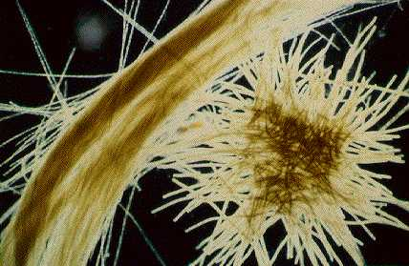
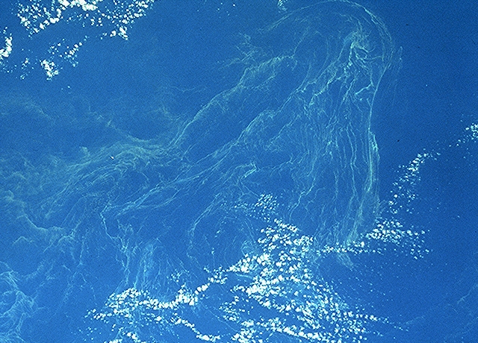
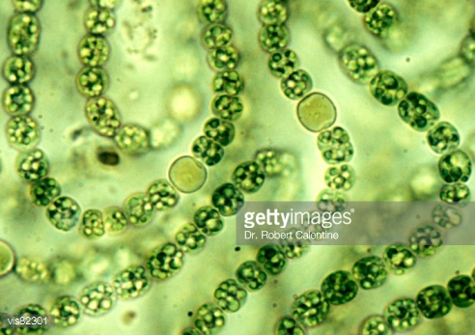
Input: Nitrogen fixation
Trichodesmium
Trichodesmium bloom
Trichome with heterocysts

Slide 10
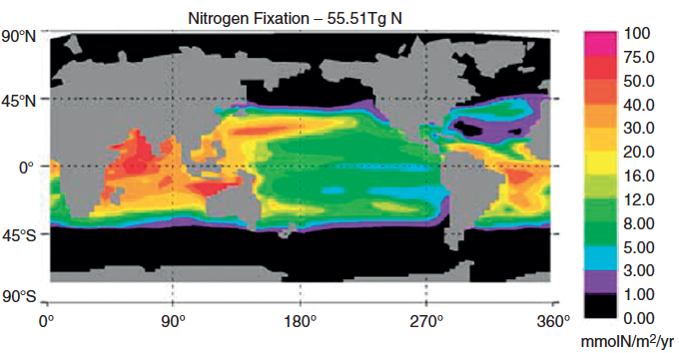
Input: Nitrogen fixation
Moore et al. 2004

Slide 11
Output: Denitrification
Major N loss : NO₃⁻ → NO₂⁻ → NO_{(gas)} → N₂O_{(gas)} → N_{2(gas)}
Occurs in anoxic water column and sediments
Performed by a large group of facultatively anaerobic heterotrophic bacteria
Produces PO₄³⁻ and CO₂:
C₁₀₆H₁₇₅O₄₂N₁₆P + 94.4HNO₃ → 106CO₂ + 55.2N₂ + H₃PO₄ + 177.2H₂O

Slide 12
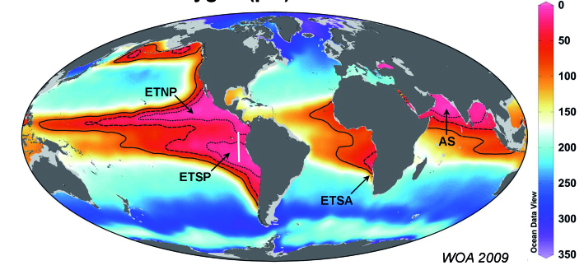
Output: Denitrification
[O₂] at 200 m (μmol/kg)
Major oxygen deficient zones (ODZ): ETNP, ETSP, Arabian Sea

Slide 13
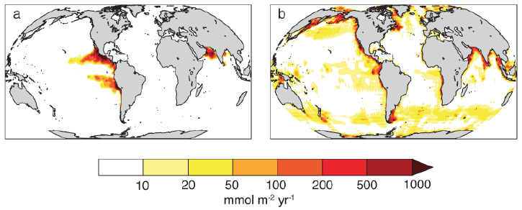
Output: Denitrification
Water column denitrification
Sedimentary denitrification
Rate of denitrification (N loss)
DeVries et al. 2013

Slide 14
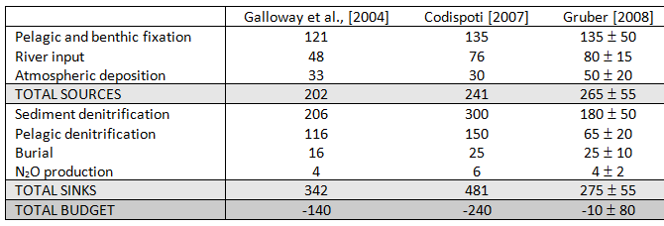
Is the marine N cycle in balance?
Annual N budget estimates (Tg N/year)
Bianchi et al. 2012

Slide 15
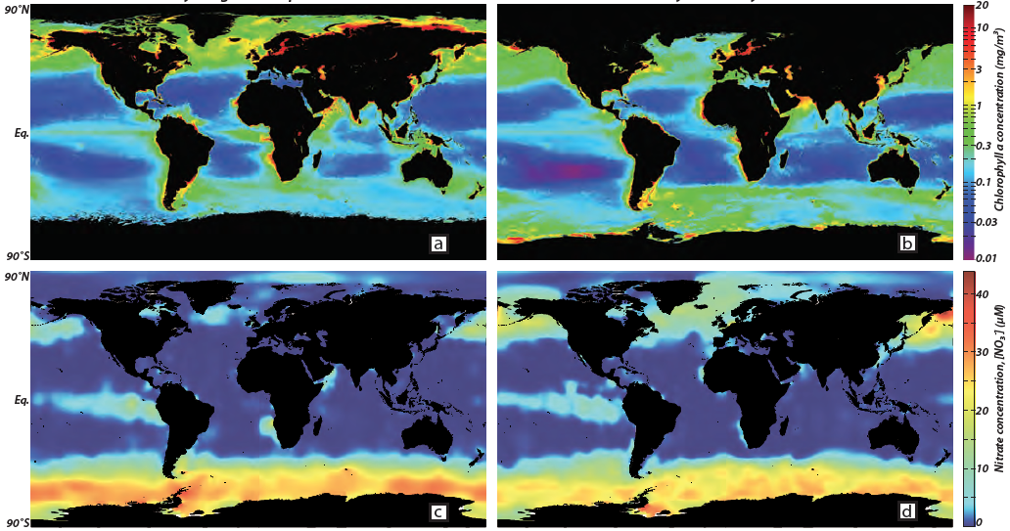
Internal cycle: N assimilation – NO₃⁻
Northern hemisphere summer
Southern hemisphere summer
Chlorophyll-a (mg/m³)
Chlorophyll-a (mg/m³)
[NO₃⁻] (μM)
[NO₃⁻] (μM)
oceancolor.gsfc.nasa.gov; www.nodc.noaa.gov; Sigman and Hain, 2012

Slide 16
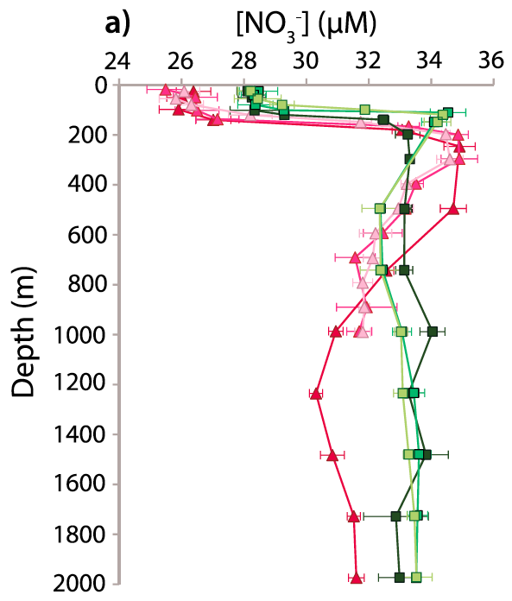
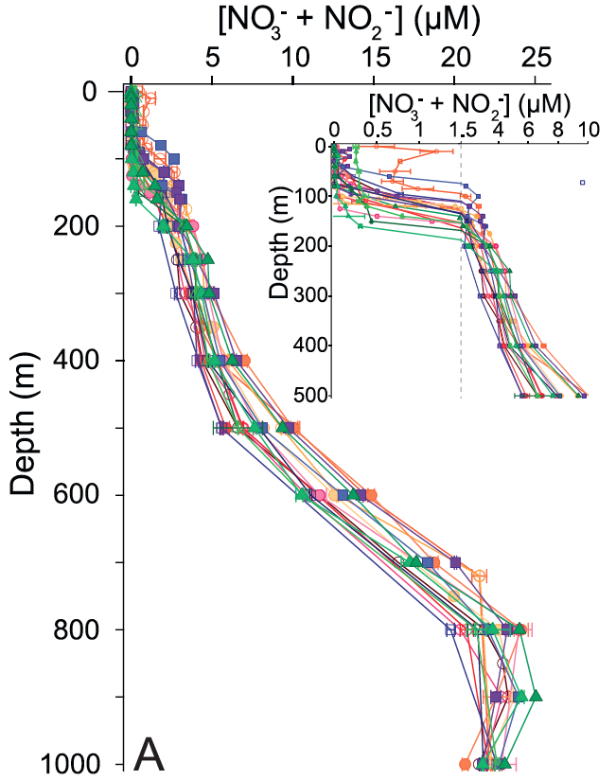
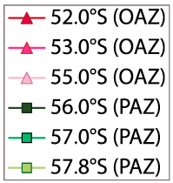
NO₃⁻ is the dominant form of bioavailable N
Atlantic Southern Ocean
Subtropical North Atlantic
Smart et al. 2015, Fawcett et al. 2015

Slide 17
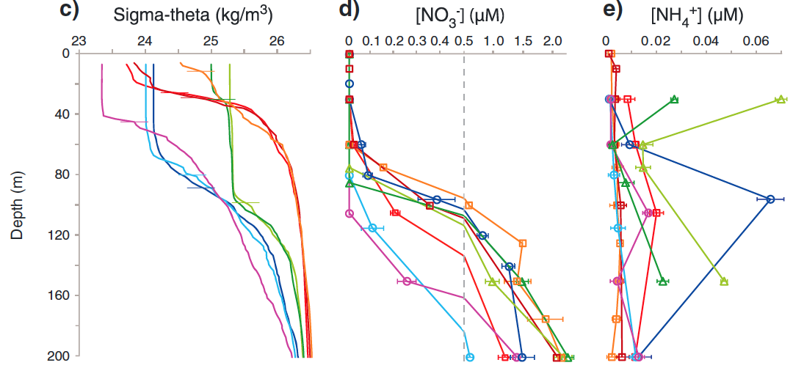
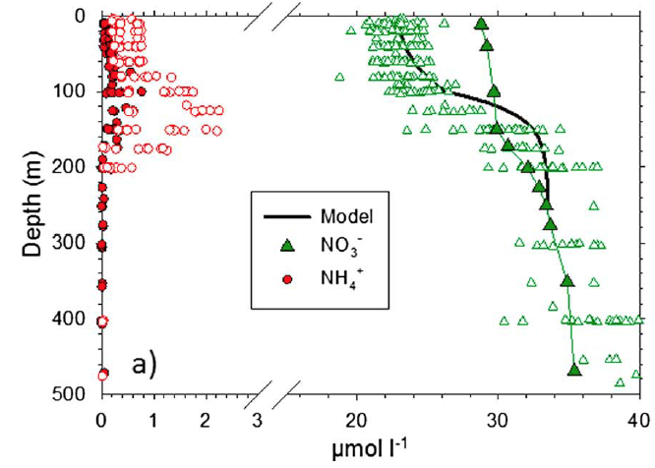
NH₄⁺: low concentration, high flux
Kerguelen Plateau
Southern Ocean
Subtropical North Atlantic
[NO₃⁻]
[NH₄⁺]
Fripiat et al, 2015, Fawcett et al. 2014

Slide 18
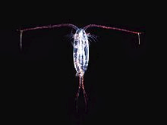
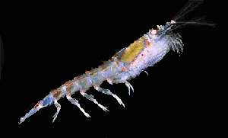
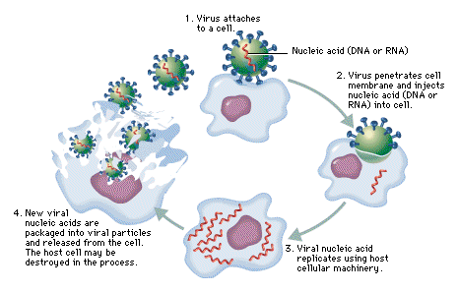
NH₄⁺: low concentration, high flux
Sources of NH₄⁺ to phytoplankton
particulate and dissolved organic N breakdown (ammonification)
grazing (zooplankton)
excretion (zooplankton)
sloppy feeding (zooplankton)
leaking cells
viral lysis
spontaneous cell death

Slide 19
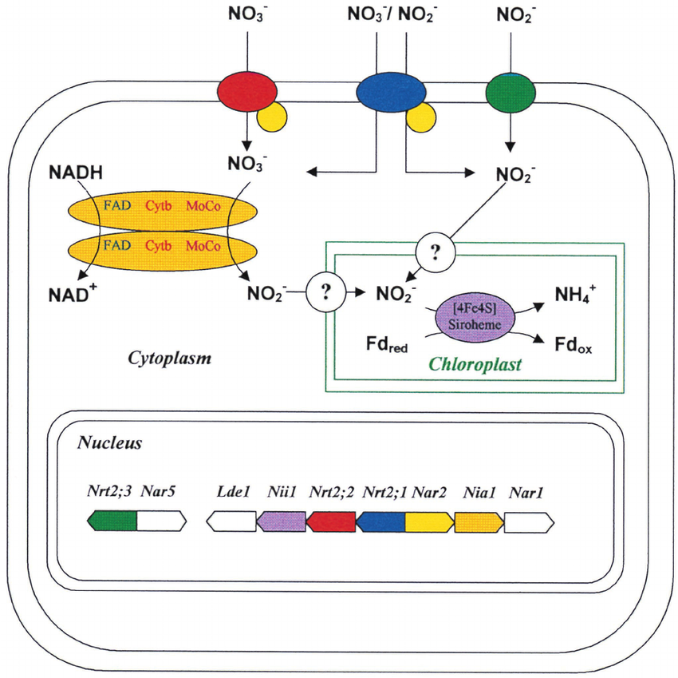
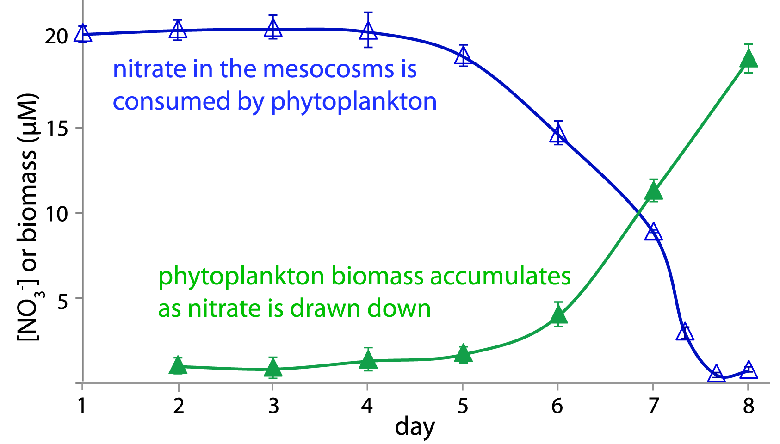
Internal cycle: N assimilation
NH₄⁺, NO₃⁻, NO₂⁻, dissolved organic N (DON) → N_{org}/PON
Phytoplankton require N (usually inorganic) for photosynthesis
NH₄⁺
Fawcett and Ward 2011; Moreno-Vivián et al. 1999

Slide 20
Internal cycle: N assimilation
55°S summer N uptake (nmol L⁻¹ d⁻¹)
55°S winter N uptake (nmol L⁻¹ d⁻¹)
NO₃⁻
NO₃⁻
NH₄⁺
NH₄⁺
euphotic zone depth
mixed layer depth
Mdutyana et al. in prep

Slide 21
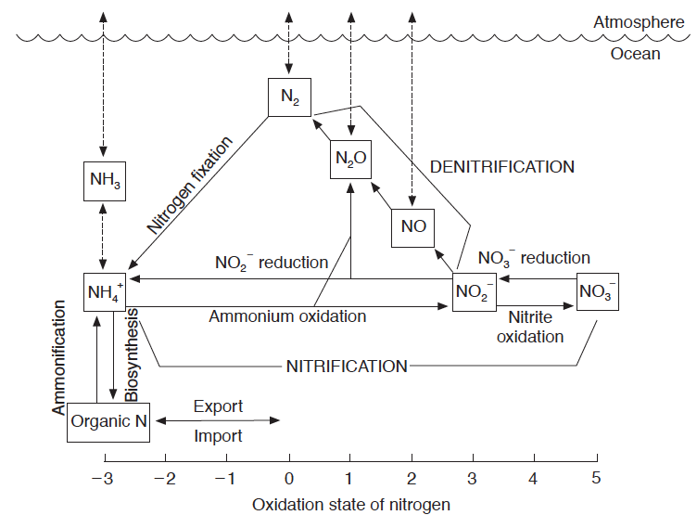
NH₄⁺ vs NO₃⁻ assimilation
Karl and Michaels 2001

Slide 22
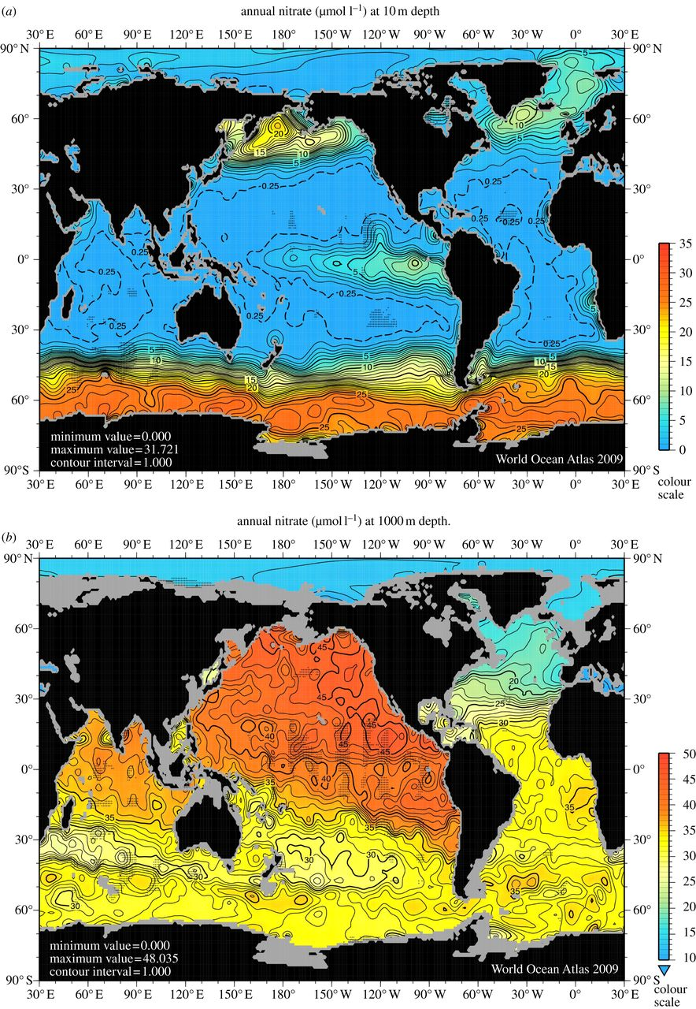
Annual average surface [NO₃⁻] (μM)
Annual average 1000 m [NO₃⁻] (μM)
Boyer et al. 2006

Slide 23
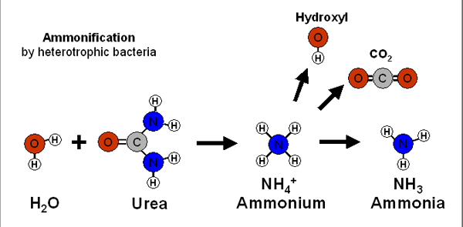
Internal cycle – remineralization
Ammonification: N_{org} → NH₄⁺ (heterotrophic bacteria)
(2) Nitrification: NH₄⁺ → NO₂⁻ → NO₃⁻ (chemoautotrophic)
+ (2) = remineralization
C₁₀₆H₁₇₅O₄₂N₁₆P + 150O₂ → 106CO₂ + 16NO₃⁻ + HPO₄²⁻ + 78H₂O + 18H⁺

Slide 24
Internal cycle – nitrification
Ammonium oxidation: NH₄⁺ → NO₂⁻
Nitrite oxidation: NO₂⁻ → NO₃⁻
Two processes facilitated by different organisms (ammonium oxidizing archaea and bacteria, nitrite oxidizing bacteria)

Slide 25
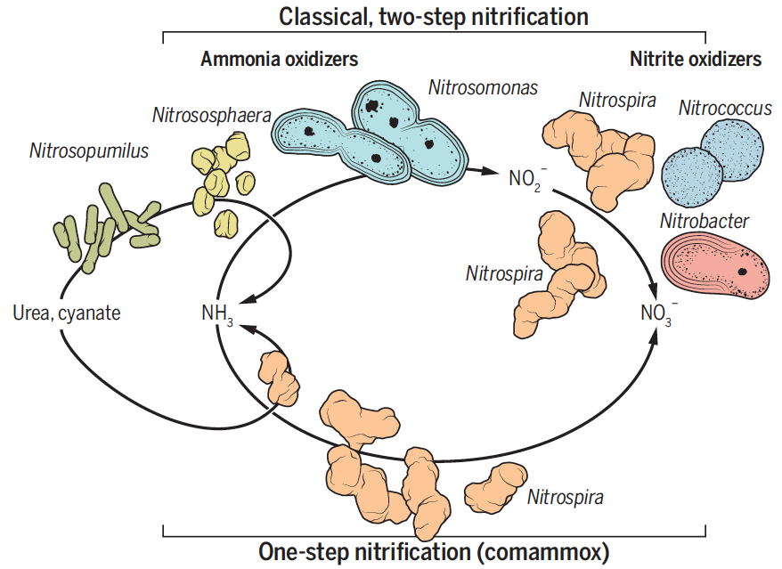
Internal cycle – nitrification
Ammonium oxidation: NH₄⁺ → NO₂⁻
Nitrite oxidation: NO₂⁻ → NO₃⁻
Two processes facilitated by different organisms (ammonium oxidizing archaea and bacteria, nitrite oxidizing bacteria)
Santoro 2015

Slide 26
Internal cycle – nitrification
Ammonium oxidation: NH₄⁺ → NO₂⁻
Nitrite oxidation: NO₂⁻ → NO₃⁻
Two processes facilitated by different organisms (ammonium oxidizing archaea and bacteria, nitrite oxidizing bacteria)
Chemoautotrophic process: energy yielding
Thought to be light-inhibited; competition with phytoplankton for NH₄⁺ (require 8-42 mols of N to fix 1 mol of C vs. 0.15 mols of N for phytoplankton) → vertical separation of assimilation and nitrification

Slide 27
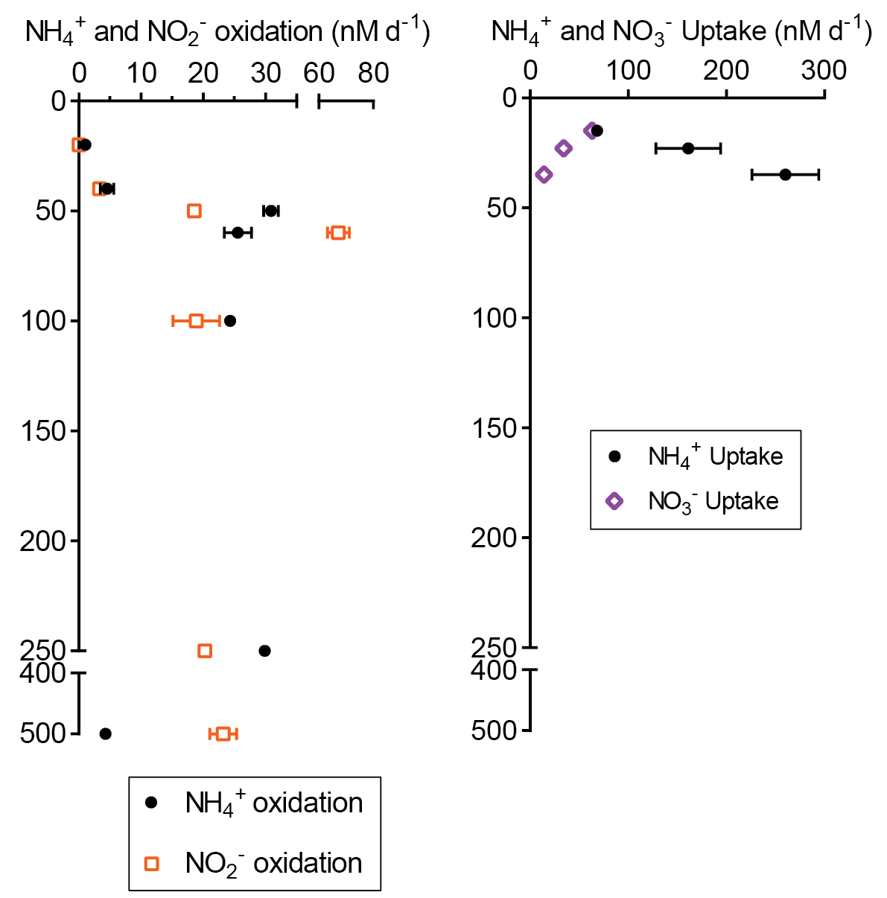
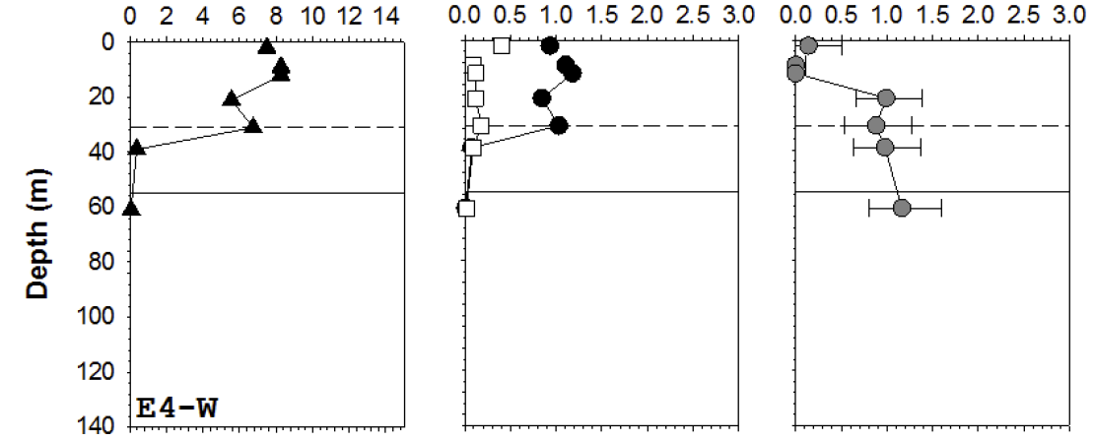
Internal cycle – nitrification
Subarctic North Atlantic
Southern Ocean
nitrification
assimilation
nitrification
assimilation
NO₂⁻ oxidation (μM d⁻¹)
N uptake (μM d⁻¹)
MLD
euphotic zone
MLD
NO₂⁻ oxidation
NH₄⁺ uptake
NO₃⁻ uptake
Peng et al. in prep; Cavagna et al. 2015

Slide 28
The marine nitrogen (N) cycle
Input/output budget is largely biologically controlled
Exists in numerous forms/oxidation states (“bioavailability”)
Oceanic residence time of ~3000 years
N₂ fixation: N_{2(gas)} → NH₄⁺ (major input)
Denitrification: NO₃⁻ → NO₂⁻ → NO_{(gas)} → N₂O_{(gas)} → N_{2(gas)} (major loss process)
N assimilation: NH₄⁺, NO₃⁻, NO₂⁻, DON directly taken up by phytoplankton and synthesized into biomass (N_{org}/PON)
Ammonification: N_{org} → NH₄⁺ (heterotrophic bacteria)
Nitrification: NH₄⁺ → NO₂⁻ → NO₃⁻ (chemoautotrophic)
Internal cycle
remineralization

Slide 29
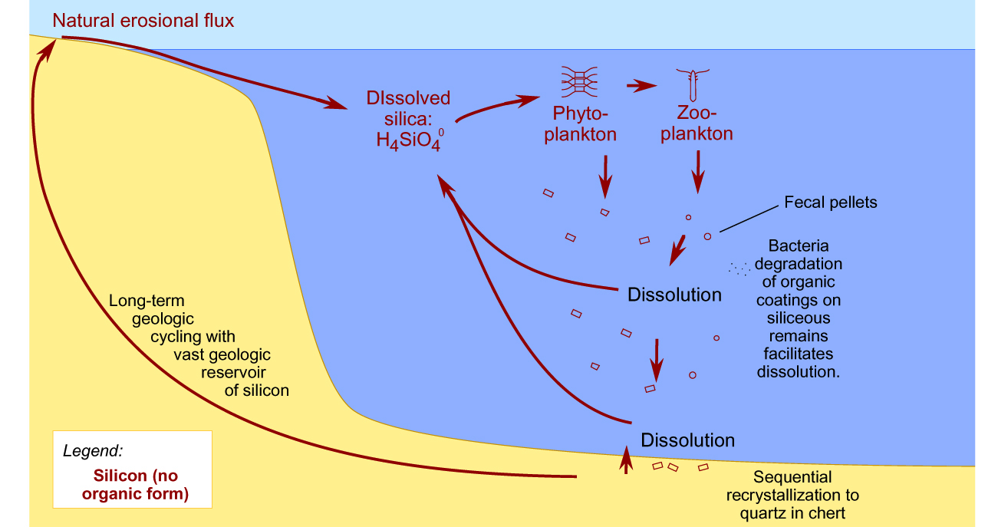
The marine silica (Si) cycle
Biogenic silica
Lithogenic
silica
Dissolved
silica Si(OH)₄
Dissolution rather than oxidative remineralization returns Si to a usable form (no organic form)

Slide 30
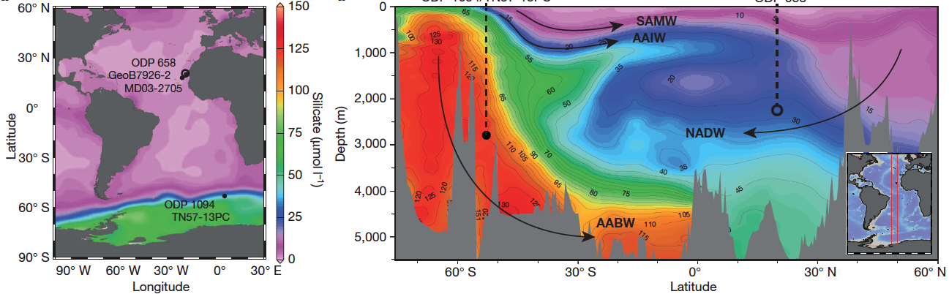
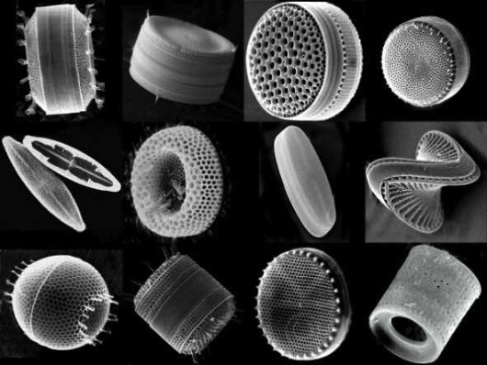
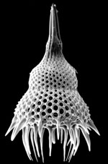
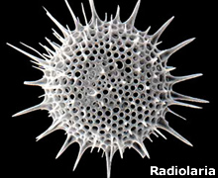
The marine silica (Si) cycle
diatoms (phytoplankton)
radiolaria (zooplankton)
Meckler et al. 2013

Slide 31
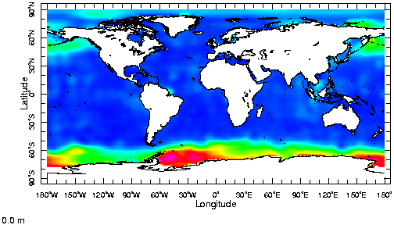
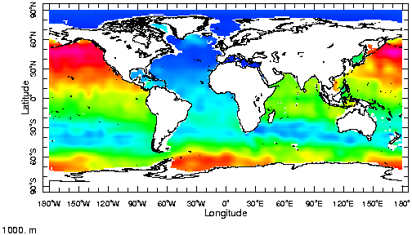
Dissolved silica concentrations
surface
1000 m

